Slide 1
Checkers

Slide 2
Final Year 1st Semester CSE 702 (AI) Presentation
Md. Sakib Hasan
Reg:2013331508
Session: 2013-2014
Md. Merazur Rahman
Reg:2013331506
Session: 2013-2014
Date: 5 August, 2018

Slide 3
Outline
Existing Work
Goal
Features
Implementation
Screen Shots
Playing Rules
Future Extension

Slide 4
Existing Work
Checker is a very popular game and it comes with a verity of rules. Different parts of the world plays checkers with different rules with different names. There are a lot of existing checker game available in Google Play Store.

Slide 5
Goal
Goal is to Develop AI based game for Final Year 1st Semester Artificial Intelligence Project.
Checkers is an AI based Android Game where one can play against machine.

Slide 6
Features
3D Android Game
Two Player
Single Player(AI)

Slide 7
Implementation
Developed by unity 3D Game Engine
Use OF Graphics
Simple AI Implementation that can calculate one move ahead

Slide 8
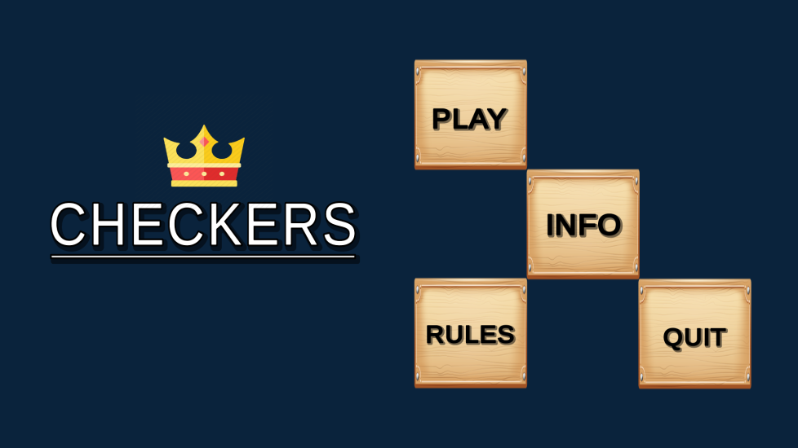
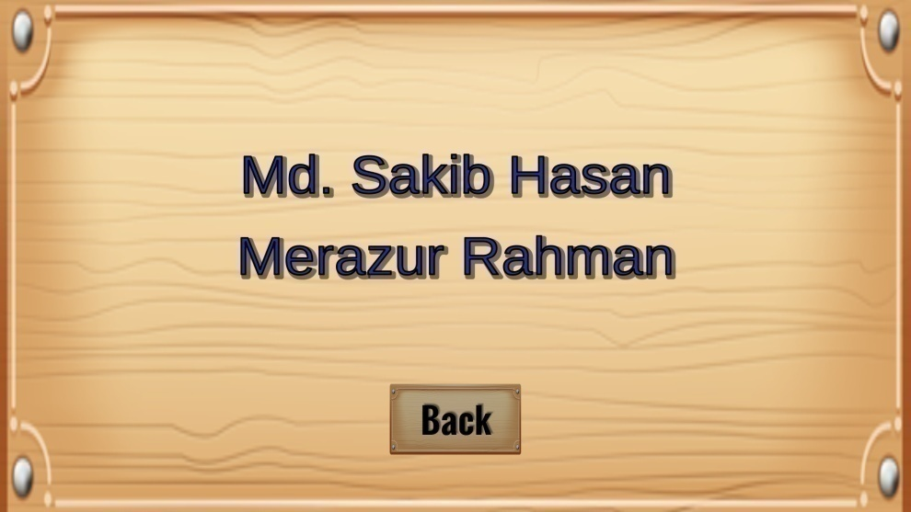
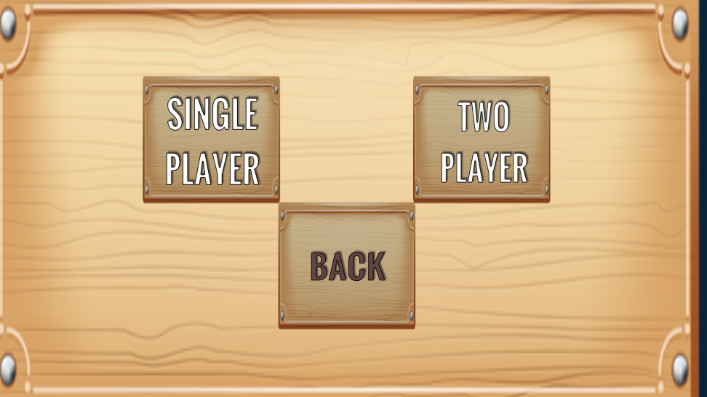
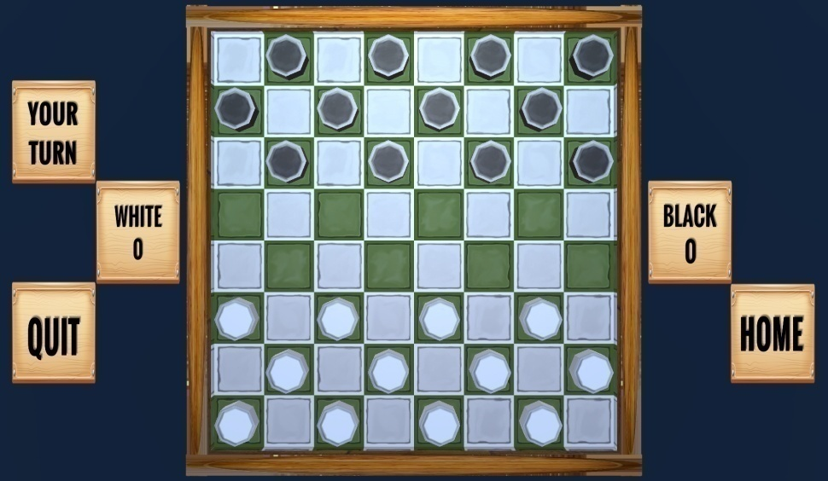
Screen Shots

Slide 9
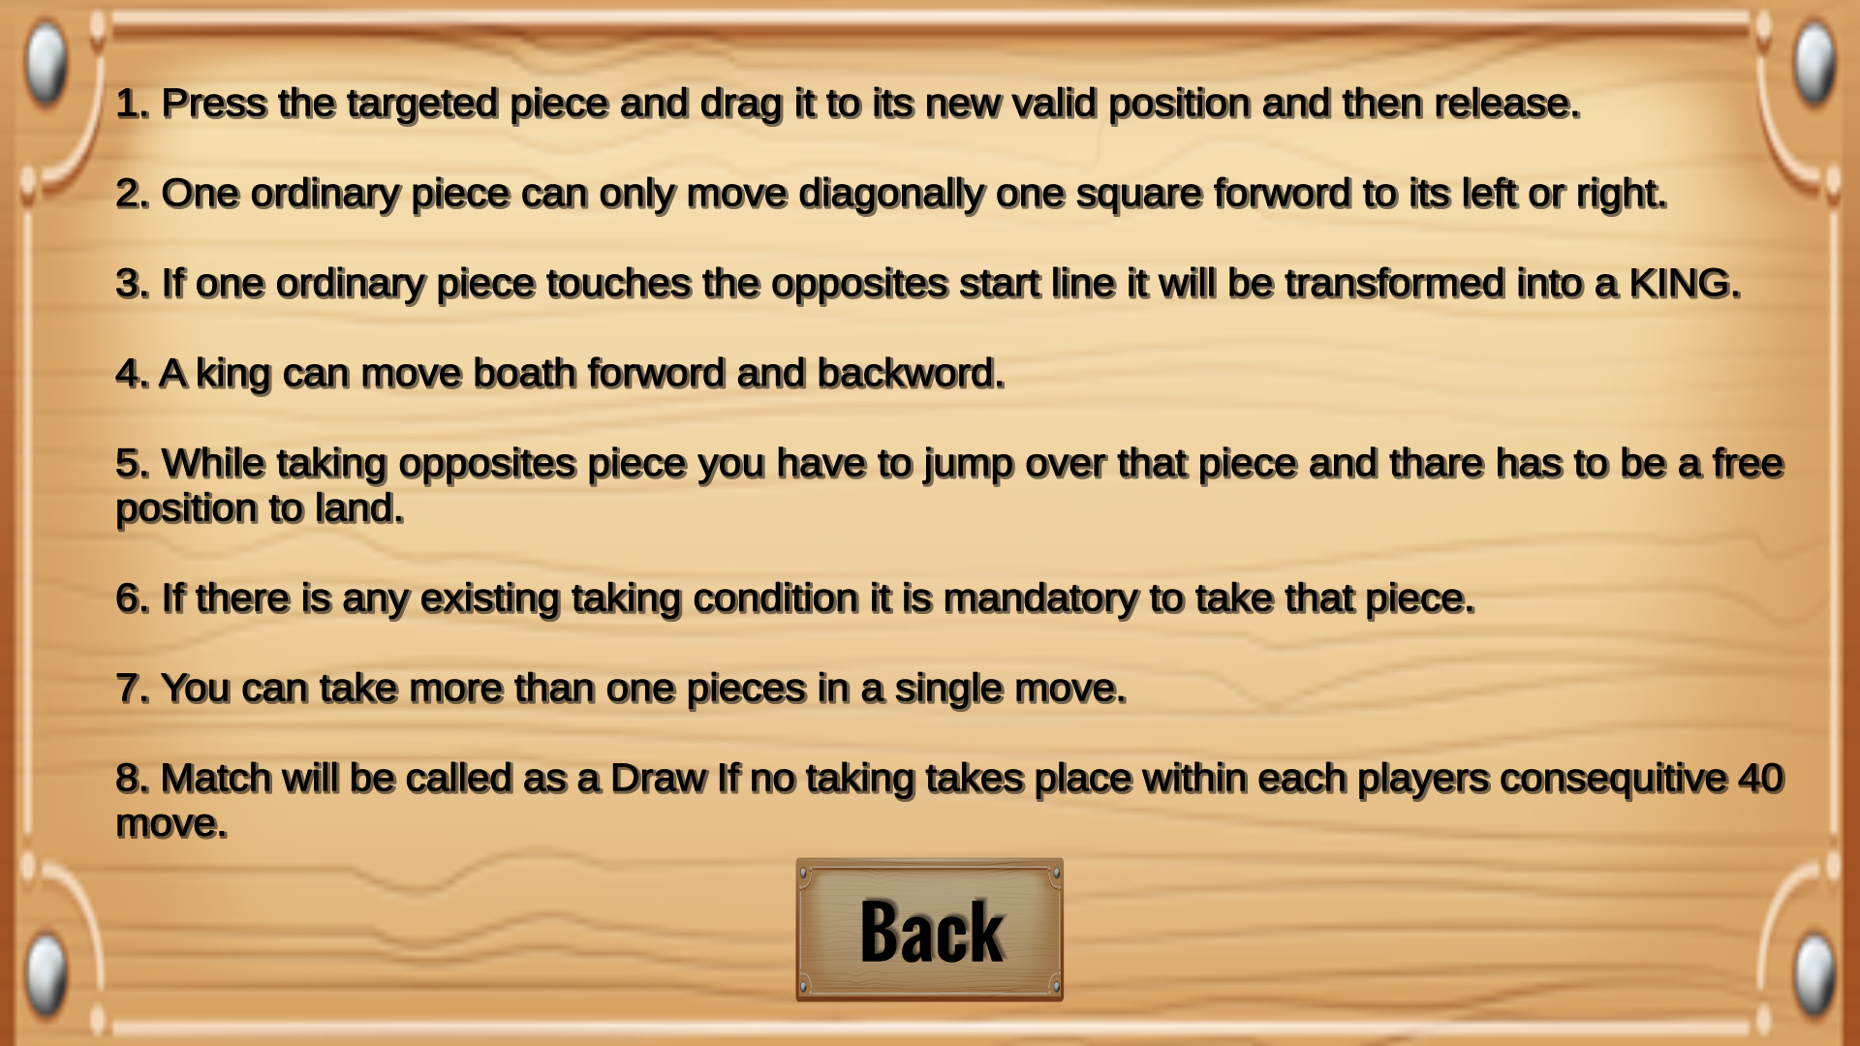
Playing Rules

Slide 10
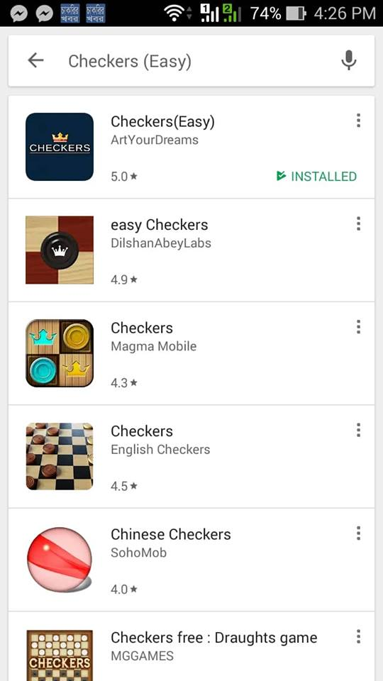
Publication
Our Game in Google Play named Checkers (Easy)

Slide 11
Future Extension
Facebook Connect
Leader Board
Multiplayer

Slide 12
Thank You

